Slide 1


LOCOBOT
CMR COLLEGE OF ENGINEERING & TECHNOLOGY
(Autonomous)
Kandlakoya, Medchal, HYDERABAD
CENTRE FOR ENGINEERING EDUCATION RESEARCH
REVIEW-II
SOCIAL INNOVATION IN PRACTICE (A400507)
IV SEMESTER A.Y 2023-24
Student Team Details
Rhea Reddy.T - 22H51A0553
Sarmista Rath - 22H51A0555
S.Koushik Kumar - 22H51A0554
G.Sowmya- 22H51A0588
P.Venkata Sai Krishna- 22H51A0550
Faculty Mentors
B. Suresh Ram, HOD CEER
K.Ravi Kiran, Asst. Professor
K.Sathish, Asst. Professor
Locobot CMR College of Engineering & Technology

Slide 2

CONTENT
Problem Statement
Existing Solutions
Proposed Solution
Components required
Block Diagram
Flow Chart
Working Principle of all components used/Software modules
Working of the model/Frontend demonstration
Results and Discussions
Advantages and Drawbacks
References

Slide 3

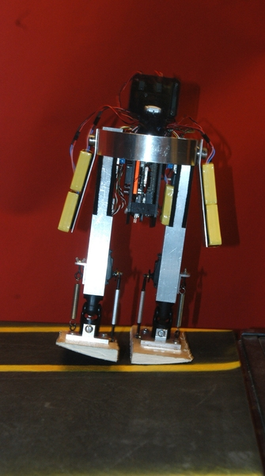
PROBLEM STATEMENT
Developing a smart, multi-functional robot capable of recognizing voice commands and responding accordingly through movement, speech and interaction with users. The robot possesses the ability to understand and execute tasks based on voice inputs, engage in meaningful conversations with users, sing songs to enhance user experience and interaction, and additionally acts as a reminder for tasks and important days.
Locobot CMR College of Engineering & Technology

Slide 4
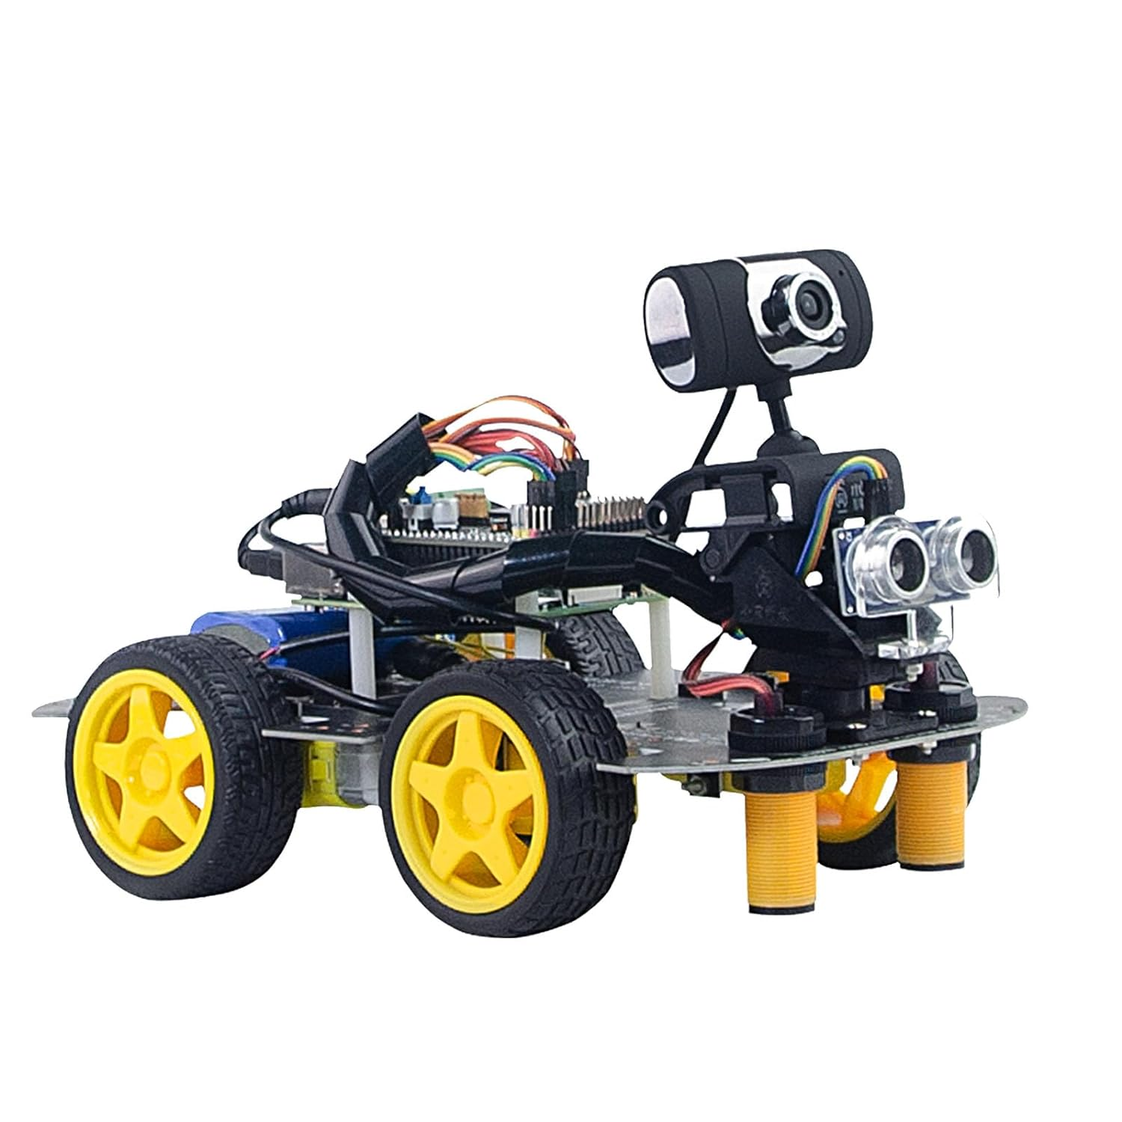
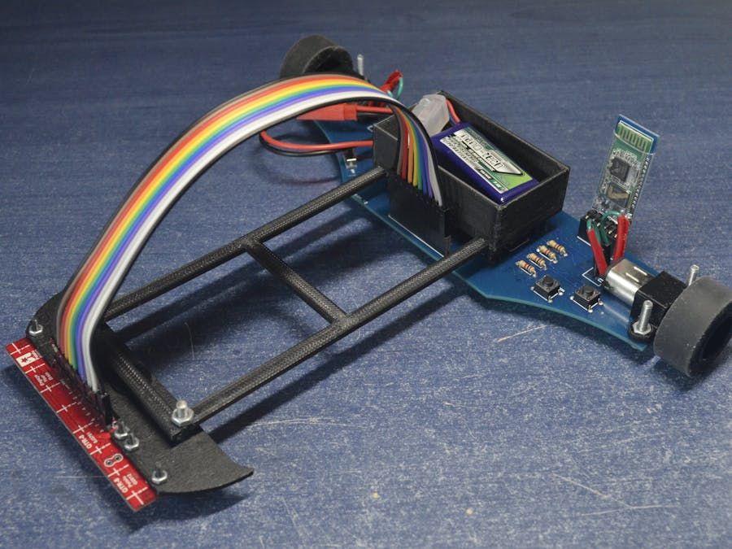
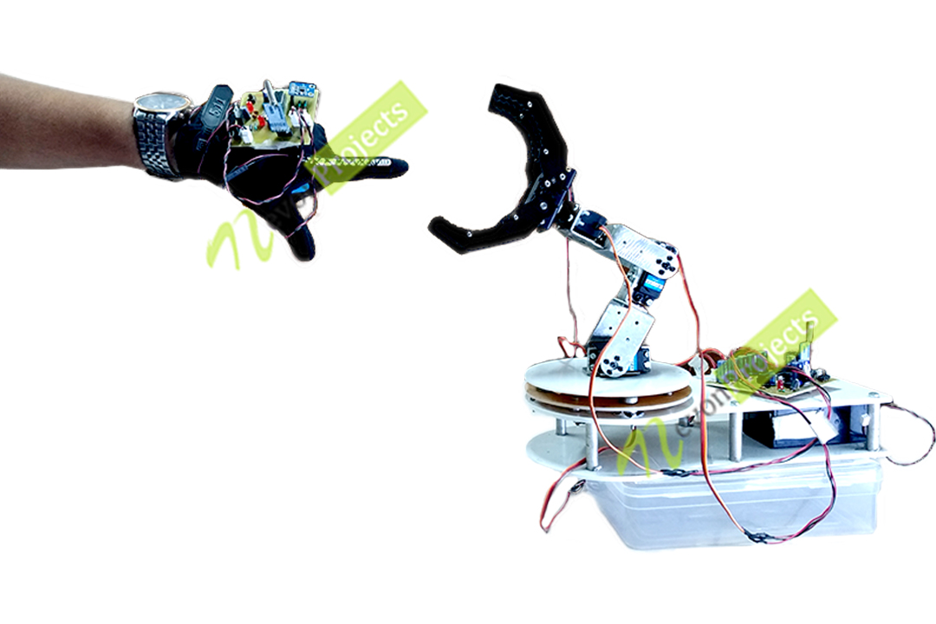
EXISTING SOLUTIONS
Smart Robot For Face Recognition
This is a smart robot that can recognize your face and of other regular visitors. If you go in front of the camera, the robot will recognize your face and It will call out your name
Line Follower Robot Using PID Algorithm
A line follower is a simple robot that follows a thick line drawn on the floor using infrared (IR) or some other optical sensors.
Wireless Gesture-Controlled Robotics Projects
A robot is controlled wirelessly using hand gestures. This is an easy, user-friendly way to interact with robotic systems and robots.
Locobot CMR College of Engineering & Technology

Slide 5
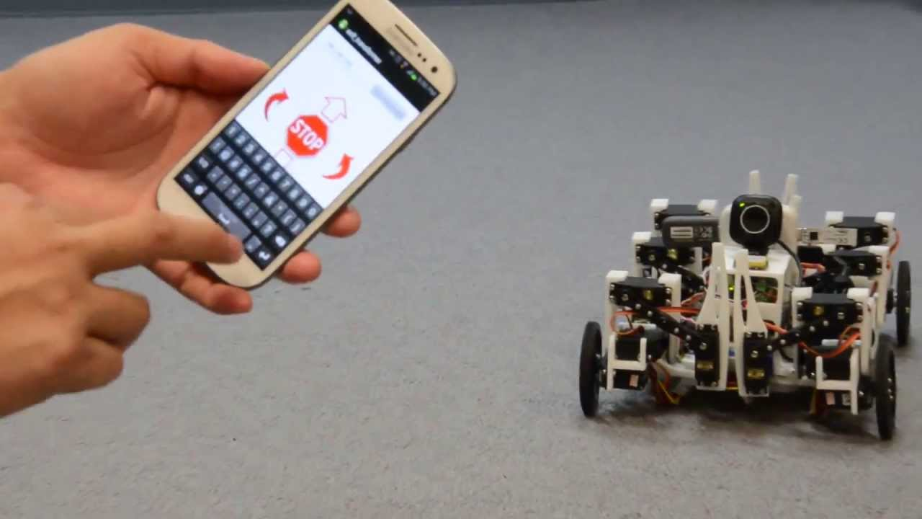
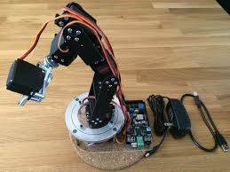
EXISTING SOLUTIONS
Android Phone Controlled Robotics Projects
This project presents a robot that can be controlled using an app running on an Android phone.
HMI-Based Robotic Arm
Certain jobs require high precision for which a human hand is needed along with the autonomous robot. HMI type of robotic arm can follow and copy the movements of human action.
Locobot CMR College of Engineering & Technology

Slide 6
PROPOSED SOLUTION
The Arduino can be used to receive voice commands from users via a phone connected to the Bluetooth module. These commands can then be forwarded to the robot's main control system for processing.
The Arduino makes use of voice recognition for understanding user commands or accessing data for speech through speaker module it can send its output.
As the robot is designed to play songs, the SD card can be used to store the speech , providing a convenient and expandable storage solution.
Through this comprehensive approach, the robot will emerge as a versatile and intelligent companion capable of recognizing voice commands.
Communicate
Iterate
Locobot CMR College of Engineering & Technology

Slide 7
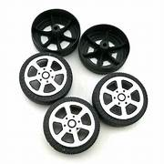
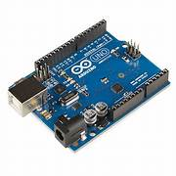
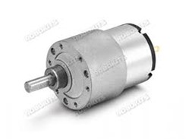
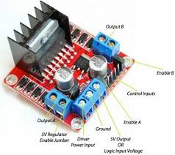
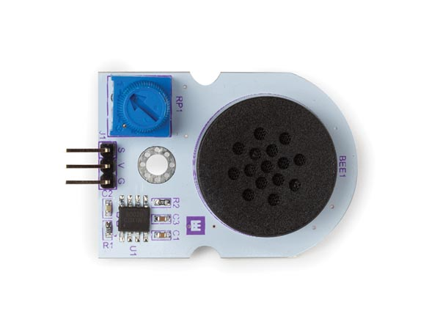
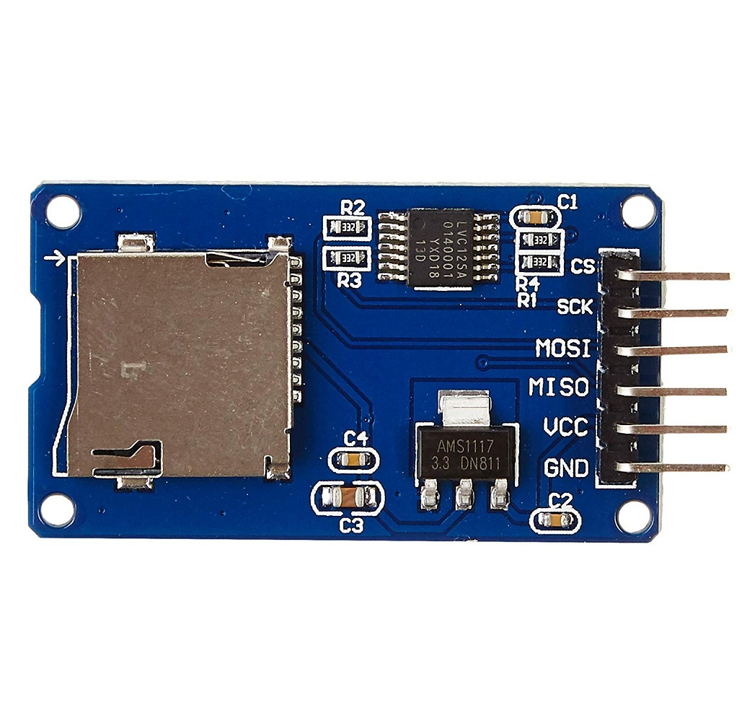
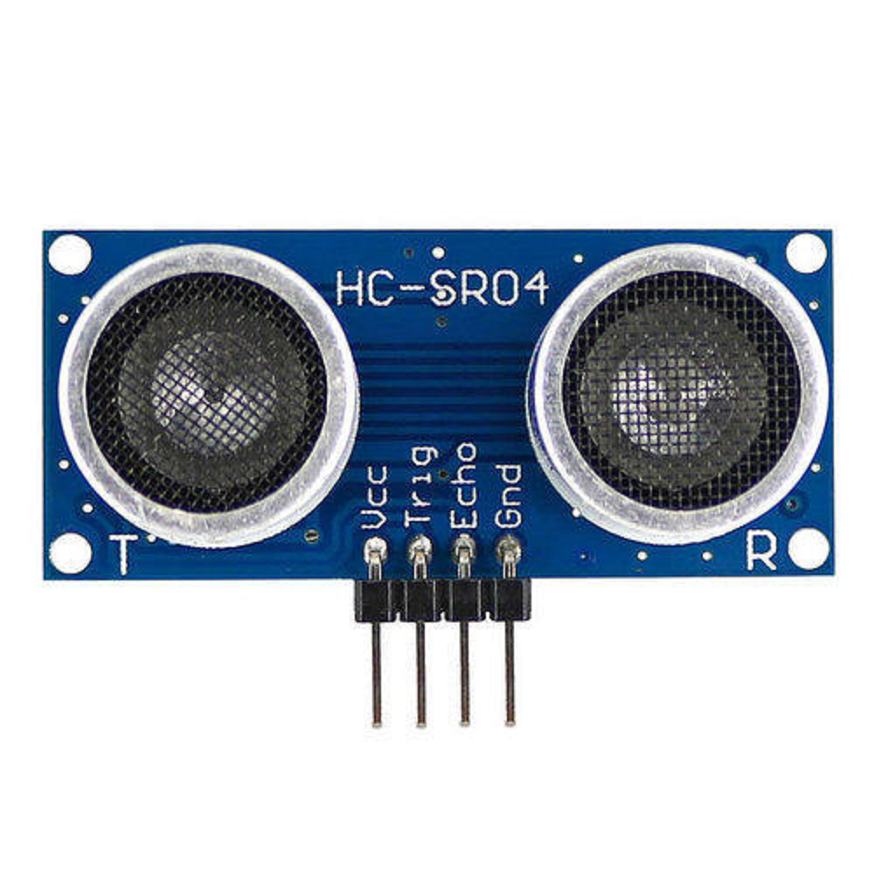
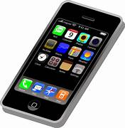
COMPONENTS REQUIRED
DC geared motors Wheels Drivers Arduino
Speaker module Phone SD card module Bluetooth
Locobot CMR College of Engineering & Technology

Slide 8
COMPONENTS REQUIRED
Software Required:
Arduino IDE
Speech Recognition Software
Text-to-Speech
Locobot CMR College of Engineering & Technology

Slide 9
BLOCK DIAGRAM (For Hardware Projects)
SD Card
Micro controller
Speaker
Phone
Bluetooth
Driver
Servo Motor
Driver
DC Motor
Locobot CMR College of Engineering & Technology

Slide 10
FLOW CHART (For Software Projects)
Start
IF button is ON
NO
YES
Roam or move
IF voice recognition==true
NO
YES
Respond
Compute task
Complete task
NO
IF voice recognition==“stop “
YES
STOP
Locobot CMR College of Engineering & Technology

Slide 11
WORKING PRINCIPLE OF ALL COMPONENTS USED/SOFTWARE MODULES
Arduino : A microcontroller that acts as a interface between the sensors and processes the code.
Bluetooth module: Provides wireless connectivity between microcontroller and mobile.
DC Motor: Connected to wheels to provide rotation
Motor Driver: Controls the DC Motor . DC Motors receive instruction from Motor Driver via Arduino
SD Card Adapter: Allows to access SD Card .
Mobile: Allows to give input to Arduino
Jumper Wires: Connects the various Sensors and devices
Battery(12V) : External power source
Speaker: Provide audio output
Locobot CMR College of Engineering & Technology

Slide 12
WORKING OF THE MODEL/FRONTEND DEMONSTRATION
User provides audio input to the Arduino via mobile phone( i.e “forward”, ”backward”, ”left”, ”right”,”hi”)
Audio is converted to text format
Bluetooth transmits the input to the micro controller from the phone
Micro controller contains code that processes the text. If the command is “forward”, ”backward”, ”left”, ”right” it sends the instructions to Motor Driver. If the command is “hi” it plays speech.
Motor drivers initiates movement from DC Motor
Locobot CMR College of Engineering & Technology

Slide 13
RESULTS AND DISCUSSIONS
Results
Functionality Achievement: Discuss the extent to which your robot achieved its intended functionalities, such as voice recognition, task execution, conversation abilities, song playback, and alarm system implementation.
User Interaction: Evaluate how effectively the robot interacts with users, including its ability to understand voice commands, engage in meaningful conversations, and provide assistance or reminders.
Performance: Present any performance metrics or benchmarks related to the robot's speed, accuracy, and reliability in executing tasks and responding to user inputs.
IoT Integration: Describe the success of integrating IoT capabilities into your robot, including its ability to receive voice commands from connected devices and access data for reminders and calendar events.
Locobot CMR College of Engineering & Technology

Slide 14
ADVANTAGES
Voice commands allow for hands-free operation, making it easier to interact with the robot.
Can be beneficial for users with disabilities or those who find it difficult to use traditional interfaces.
Easy to upgrade storage capacity by changing the SD card.
Arduino is highly customizable and can be programmed to suit various needs.
Using Arduino and other readily available components can keep costs relatively low compared to commercial robots.
Locobot CMR College of Engineering & Technology

Slide 15
DRAWBACKS
Bluetooth has a limited range, which may restrict the robot's mobility and usability.
Other Bluetooth devices in the vicinity may cause interference.
The combination of Bluetooth, voice recognition, and audio playback can drain the robot’s battery quickly, requiring frequent recharges.
Differentiating between voices of multiple users can be challenging, potentially leading to confusion or misinterpretation of commands.
Integrating the robot with existing home automation systems can be complex and require additional programming.
Locobot CMR College of Engineering & Technology

Slide 16
REFERENCES
Murphy, Robin R., et al. "Human–robot interaction." IEEE robotics & automation magazine 17.2 (2010): 85-89.
Kosuge, Kazuhiro, Manabu Sato, and Norihide Kazamura. "Mobile robot helper." Proceedings 2000 ICRA. Millennium Conference. IEEE International Conference on Robotics and Automation. Symposia Proceedings (Cat. No. 00CH37065). Vol. 1. IEEE, 2000.
Haddadin, Sami, Alessandro De Luca, and Alin Albu-Schäffer. "Robot collisions: A survey on detection, isolation, and identification." IEEE Transactions on Robotics 33.6 (2017): 1292-1312.
https://projecthub.arduino.cc/anova9347/line-follower-robot-with-pid-controller-01813f
https://www.electronicsforu.com/electronics-projects/smart-robot-face-recognition
https://www.instructables.com/Wireless-Gesture-Controlled-Robot-Using-Micro-cont/
Locobot CMR College of Engineering & Technology

Slide 17


Slide 18

Questions…..

